Slide 1
EMS Interoperability Task Force May 9, 2024
Data Needed: Patient History to EMS
Notes:
This meeting is being recorded and will be posted. If you need anything removed from the recording, let us know.
Any new participants?

Slide 2
Task Force Overview
Monthly, 2nd Thursday, 11a–12:30p MT
Topics:
2/23: Identifying data exchange partners and establishing relationships
3/23: Governmental, regulatory, and contractual environment
4/23: Regulatory environment and national networks recap
5/23, 6/23: Sequence/workflow
7/23: Standards and profiles overview
8/23, 9/23, 10/23: Standards and profiles to use in workflow
11/23, 1/24: Patient identification and record matching
Data elements to be shared and parsed:
2/24: Hospital Outcomes to EMS
4/24: EMS to Hospital
5/24: Patient History to EMS
6/24: Wrap-up call
Notes:
Reminder of task force purpose: to help EMS software vendors develop interoperability solutions for their customers
Wrap-up call: discuss at end of this call.

Slide 3
Today’s Topics
Patient information needed by EMS on a 911 call
June call and future task force activities

Slide 4
Today’s Question
What information does EMS need on its patients when responding to a 911 call?

Slide 5
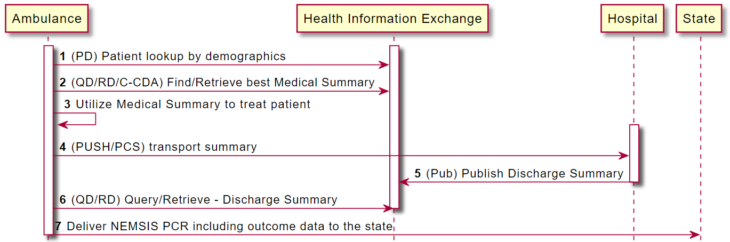

Slide 6
Demographics
Legal name
Current address
Current healthcare providers
Preferred language

Slide 7
Clinical (critical)
Advance Directives (DNR, PMO, POLST)
Pertinent medical history (diagnoses currently being treated)

Slide 8
Clinical (additional)
Allergies (medications, food, environmental)
Medications (current/prescribed/dispensed)
Recent vitals (BP, HR, RR, O2, Temp)
Recent ECGs (if cardiac issue)
Recent healthcare encounters (date, location)
Recent diagnostic tests (labs, images)
Pertinent surgical history (procedures)
Barriers to care

Slide 9
What’s “Pertinent?”

Slide 10
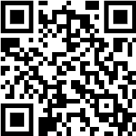
Did We Answer Today’s Question?
What information does EMS need on its patients when responding to a 911 call?
Notes:
Give link to survey in chat:
https://forms.office.com/r/Z1ER9MqctE

Slide 11
Wrap-up Call June 13
Pharmacy interoperability (for current medications)
Next steps for TEFCA support for outcomes queries
Barriers to incorporating outcome data into NEMSIS exports
Changes to NEMSIS standard to improve interoperability
NEMSIS TAC’s next steps on interoperability

Slide 12
Next Steps
Future of the Task Force after monthly meetings end
Meetups @ NASEMSO Annual Meeting, May 14–16
Survey for today’s task force call
Notes:
Ending task force calls doesn’t mean we’ve finished. It means we’ve collected enough information to know our path forward and the work we need to do over the next few years.
Future: Keeping Google Group in place for collaboration.

